Slide 1
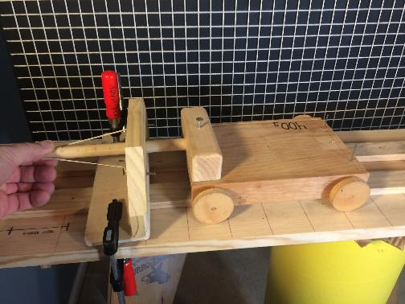
Work & Energy
Work-Energy Theorem
LabRat Scientific
© 2019

Slide 2
Mechanical Work
Mechanical Work is performed when a Force acts over a Distance ( W = F x d ) and has the units of Newton*meter (N*m) or foot*pounds (ft*lb).
The Force and Distance can be plotted on a graph. The Mechanical Work is area under the Force-Distance curve.
Force (N)
Force (N)
Work = Area
Work = Area
Distance (m)
Distance (m)
Constant Force
Variable Force
For simple Force-Distance curves (as depicted above) simple geometry can be used to calculate the area under the force curve. However, for more complex Force-Distance curves, calculus may have to be applied.

Slide 3
Mechanical Energy
While Mechanical Work is fairly easy to comprehend (it’s a force acting over some distance…), Mechanical Energy is a little more difficult to mentally visualize.
There are two commonly known forms of Mechanical Energy:
1. Gravitational Potential Energy
2. Kinetic Energy

Slide 4
Gravitational Potential Energy (PE=mgh) is known as the energy of position. Units = N*m (or ft*lb)
The gravity force acting on a brick held at a height of five feet above the floor is doing no work while the brick is suspended at five feet because it is not moving (W = F x d_{moved} and the distance moved = 0), but it has the potential to do work if the brick is released – as such, it has “energy” or the “ability to do work”.
Distance
Force = Weight
When dropped, the Gravitational Force (F = Weight = mg) on the brick can start to perform work because the brick (and its inherent weight force) is free to move. In this case, the force is being applied over the fall distance (work = force x distance).

Slide 5
Kinetic Energy (KE = ½ mv²) is known as the energy of motion. Units = N*m (or ft*lb)
If a brick is moving at a constant velocity it is by definition not being accelerated. If it is not being accelerated, the sum of the forces (i.e. pulling/pushing, friction, drag, etc) acting on the brick must be zero (Force_{Net} = 0). This is Newton’s 2nd Law in action.
Velocity = Constant
Net Force = 0
Work is a Force acting over a Distance, and while the moving brick results in a “distance” being covered over time, the lack of a net force means no work is done.

Slide 6
However, if the moving brick collides with another object it will generally slow down. This means the brick will have a negative acceleration (a.k.a. deceleration). If there is an acceleration, then a net force must exist. While the distance over which this force acts may be short, it is occurring over a finite distance.
Time = t
Clink!
Time = t + dt
As such, there is a Force acting over a Distance, and thus Work is done. Hence, Kinetic Energy has the ability to do work…
Time = t + 2dt
The amount of work done by the brick is equal to the change in Kinetic Energy of the brick as a result of the collision.

Slide 7
Force
Vel₁ =
If the brick is being accelerated, by definition it must have a force acting on it (F=ma).
As such, that force is acting over some distance and as a result, there is energy in the system and it is the energy of motion...
Force
Vel₂ = Vel₁ + dv
Force
Vel₃ = Vel₂ + dv
Distance

Slide 8
Relationship between Work and Energy
You will notice that Work and Mechanical Energy have the same units (N*m or ft*lb).
This means the two must be related in some manner…
Energy is “the ability to do work”, and this is why it can be difficult to envision – after all, how does one envision the “ability” to do something?
The idea of “ability” in the definition of energy implies that work is stored in an object in some manner. In fact, the term “energy” comes from Greek meaning “work-within”.
Mechanical Work can be related to Mechanical Energy via the Work-Energy Theorem.

Slide 9
Deriving the Work - Energy Theorem
Work = Force * Distance = F * x
Eq 1
F = ma
Eq 2
Combining Eq 1 and Eq 2 yields:
Work = ma * x
v_{t} - v₀
Acceleration = a = ----------
t
Where:
V₀ = Object’s initial speed at t = 0
V_{t} = Object’s speed at time = t
Acceleration is the change in velocity divided by time: Accel = (ft/sec) / sec = ft/sec²
v₀ + v_{t}
Distance = x = --------- t
2
Distance is the average velocity of the object multiplied by time: Dist = ft/sec * sec = ft

Slide 10
Substituting in the equations for acceleration (a) and distance (x) yields:
v_{t} - v₀ v_{t} + v₀
Work = m * -------- * --------- t
t 2
Work = ½ m ( v_{t} - v₀ ) * ( v_{t} + v₀ ) (t/t)
Work = ½ m ( v_{t}² + v_{t}v₀ - v_{t}v₀ - v₀² )
Apply some basic algebra…
Work = ½ m v_{t}² - ½ m v₀²
½ mv² is the equation for Kinetic Energy, and the right hand side of the new Work equation is the Change in Kinetic Energy…

Slide 11
Work - Energy Theorem
Work = ( ½ x Mass x Velocity_{Time t}² ) - ( ½ x Mass x Velocity_{Initial}² )
If we define: KE₀ is the initial Kinetic Energy
KE₁ is the Kinetic Energy at some later Time = t
The short hand version of the Work-Energy Theorem can be written as follows:
Work = KE₁ - KE₀
The Work-Energy Theorem deals with unbalanced forces that result in an acceleration being applied to an object.
Notice that if there is no change in velocity (i.e. Vel₁ = Vel₀) there is no work done...

Slide 12
Work - Energy Theorem
The Work-Energy Theorem allows us to calculate the velocity change experienced by an object if we know how much work is done on that object.
The best way to explain this is through an experiment. This allows us to see that the theory does predict what will happen in reality...

Slide 13
Simple experiment to test the Work-Energy Theorem
Ultrasonic Motion Sensor
Rubber Band
Rolling Cart
Retention Force
Spring Force = 10
Cart Velocity = 0
A rubber band will be used to shoot a cart down a track. The Work done by the rubber band will be used to calculate the theoretical velocity of the cart when the rubber band is fully relaxed (F=0).

Slide 14
Simple experiment to test the Work-Energy Theorem
Ultrasonic Motion Sensor
Rubber Band
Rolling Cart
Spring Force = 10
Cart Velocity = 0
When the cart is released, the rubber band applies a force to the cart’s stinger. This force causes the cart to accelerate.

Slide 15
Simple experiment to test the Work-Energy Theorem
Ultrasonic Motion Sensor
Rubber Band
Rolling Cart
Spring Force = 5
Cart Velocity = 3
As the cart moves and the rubber band begins to relax, the force produced by the rubber band decreases.

Slide 16
Simple experiment to test the Work-Energy Theorem
Ultrasonic Motion Sensor
Rubber Band
Rolling Cart
Spring Force = 2
Cart Velocity = 6
As the cart moves and the rubber band begins to relax, the force produced by the rubber band decreases.

Slide 17
Simple experiment to test the Work-Energy Theorem
Ultrasonic Motion Sensor
Rubber Band
Rolling Cart
Spring Force = 0
Cart Velocity = 7
As the cart moves and the rubber band begins to relax, the force produced by the rubber band decreases.

Slide 18
Simple experiment to test the Work-Energy Theorem
Ultrasonic Motion Sensor
Rubber Band
Rolling Cart
Spring Force = 0
Cart Velocity = 7
The velocity of the cart just as the rubber band becomes fully relaxed will be used since friction will quickly slow down the cart once the rubber band force is removed.

Slide 19
Simple experiment to test the Work-Energy Theorem
Ultrasonic Motion Sensor
Rubber Band
Rolling Cart
Spring Force = 0
Cart Velocity = 6.5
The velocity of the cart just as the rubber band becomes fully relaxed will be used since friction will quickly slow down the cart once the rubber band force is removed.

Slide 20
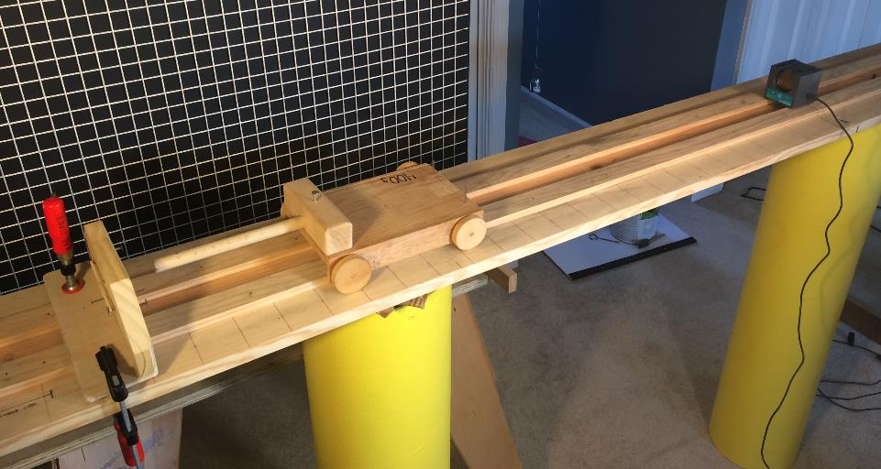
Experimental Set-up
Motion Sensor
Rubber Band Spring
Cart

Slide 21
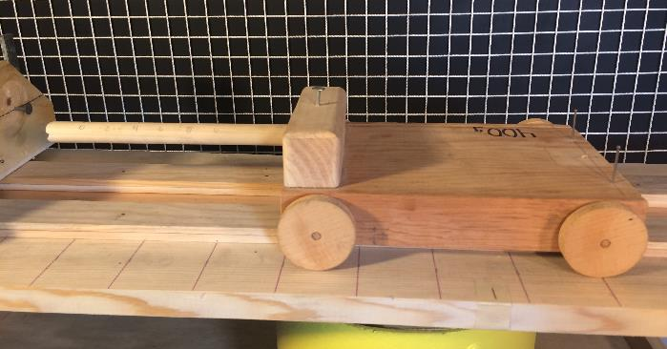
Cart Mass: 0.40 kg

Slide 22
Compensating for Rolling Friction
The rolling friction of the cart was of concern for this experiment. To compensate for friction, the track was inclined (down hill) approximately 5 deg.
This angle was determined experimentally by setting the incline then applying a small impulse to the cart to get it rolling. The experiment was repeated with different incline angles until the cart rolled down the track at a constant velocity. The constant velocity means the acceleration of the cart was zero, which means the gravitational force was equal and opposite to the dynamic friction force.

Slide 23
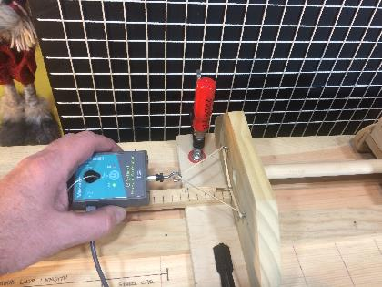
Experimental Data
Step 1: The force generated by the stretched rubber band is measured at various
stretched lengths.
Actual Test Data
This data is then be used to create the Potential Energy Force-Distance graph.

Slide 24
Experimental Data
Step 2: The work performed by the rubber band can be determined by calculating
the area under the force curve.
The measured data was not quite linear, but it was straight enough so the area could be approximated using a simple right triangle.
Area = ½ x Base x Height
Area = ½ x 0.1 m x 5 N
Area = 0.25 N*m
Work_{Rubber Band} = 0.25 N*m

Slide 25
Theoretical Computations
Step 3: Calculate the anticipated theoretical result (i.e. cart velocity)
Work = KE₁ - KE₀
Work = Area under Force Curve
= 0.25 N*m
KE = ½ x Mass x Vel²
Work-Energy Theorem
From earlier computation
Equation for Kinetic Energy
Since the cart started from a resting position, the initial Kinetic Energy (KE₀) is zero. As such, the Work-Energy equation becomes:
Work = KE₁
Work = ½ x Mass x Vel₁²

Slide 26
Theoretical Computations
Algebra can be applied to the Work-Energy equation to determine the theoretical velocity of the cart just when the rubber band becomes fully relaxed (Force=0):
Vel = ( 2 x Work ) / Mass
Vel = ( 2 x 0.25 N*m ) / 0.40 kg
Vel = 1.12 m/sec

Slide 27
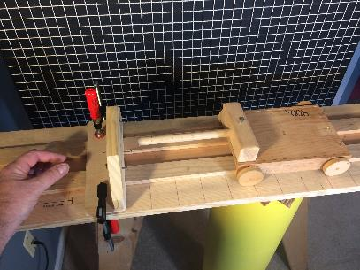
Step 4: Conduct the experiment – make multiple trials
Rubber Band fully stretched (10 cm)
Force = 5.25 N
Cart Released
Force = 0 N
See the companion LabRat Video to see the experiment in action…

Slide 28
Experimental Results
Step 5: Compile the experimental data from multiple experimental trials
A ultrasonic motion sensor was used to measure the velocity as a function of time during the test.
Alternate Data Collection Method: A ruler could have been placed along the track and then video frames could be counted to obtain velocity data…

Slide 29
Step 6: Compare results and draw conclusions
 | Cart Velocity
Theoretical | 1.12
Measured | 1.05
The variation between the theoretical result and the experimental result is about 5%. Considering the crudity of the experimental set up (wooden cart + wooden track + rubber band spring + resolution of the digital scale and motion detector) the results can be considered reasonable.

Slide 30
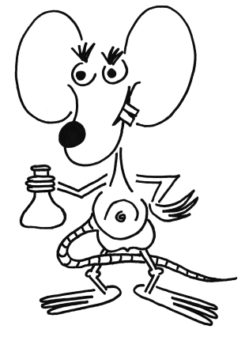
Student Discussion:
How can this experiment be enhanced to hopefully reduce the percent difference between theory and experiment?

Slide 31
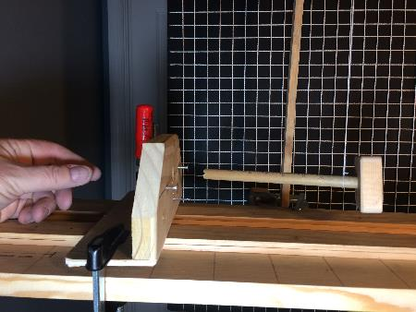
Example Alternative Approach
Pendulum String
Rather than use a wheeled cart that has friction, a simple pendulum arrangement was used to support a projectile that was propelled by the rubber band spring.
The pendulum string was made sufficiently long to allow the projectile to follow a path that was essentially linear during the data period.
The system friction was limited to friction between the projectile stinger and the rubber band plate guide hole. This friction was minimal.
Rubber Band Plate
Projectile and Stinger

Slide 32
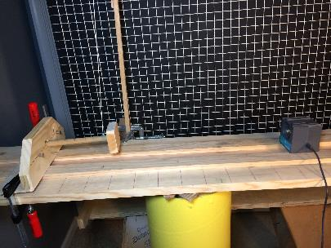
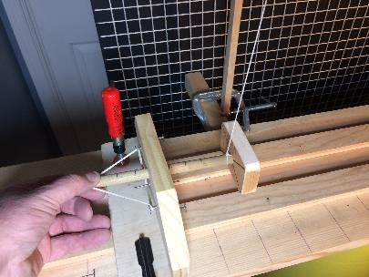
Experimental set-up showing location of the Motion Sensor relative to the projectile during the period of interest.
The Projectile & Stinger = 0.06 kg
Motion of Projectile
Motion Sensor
For this experiment, the rubber band spring was only stretched to 6 cm (0.06m) to keep the velocity low to ensure acceptable data quality.

Slide 33
Experimental Results
 | Projectile Velocity
Theoretical | 1.7
Measured | 1.62
The variation between the theoretical and experimental velocity is approx. 5% - which is similar to the cart tests.

Slide 34
Since the percent error is similar for both tests it’s reasonable to conclude that the errors were driven by something other than friction.
For example, the force measuring device used to measure the rubber band spring force and cart/projectile masses had a 0.01 kg accuracy, which is sufficient to create the observed velocity discrepancies.

Slide 35
Conclusion
1. The experimental results show that the Work-Energy
Theorem is valid.
Experimental data will likely not match theoretical data
due to sensor issues and undesirable effects such as
friction. Care must be taken when designing an
experiment in order to minimize the impact of these
undesirable effects.

Slide 36
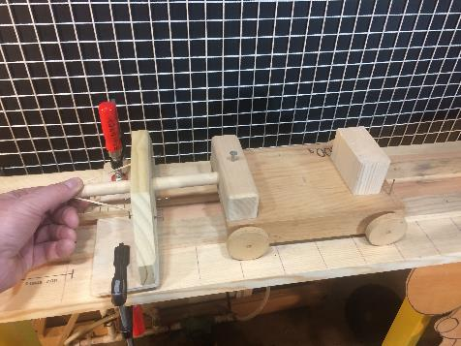
Questions ?

